Slide 1
1.6.8.2 Additive inverses of complex numbers

Slide 2
Introduction
In this topic, we will
Define the additive inverse of a complex number
Determine how to calculate this inverse

Slide 3
The additive inverse
Given a complex number z = α + β j, the additive inverse –z is that number such that
z + (–z) = 0
Thus, assume –z = γ + δ j, so we have that
(α + β j) + (γ + δ j) = 0 + 0j
(α + γ) + (β + δ) j = 0 + 0j
Now, two complex numbers are equal if and only if both the real and imaginary components are equal, so thus
α + γ = 0 and β + δ = 0
Thus, γ = –α and δ = –β, so
–z = –α – β j

Slide 4
The additive inverse
For example, if z = 0.7 – 8.4j, then –z = –0.7 + 8.4j,
it follows that
If w = –9.6 + 0.1j, then –w = 9.6 – 0.1j,
and again we see

Slide 5
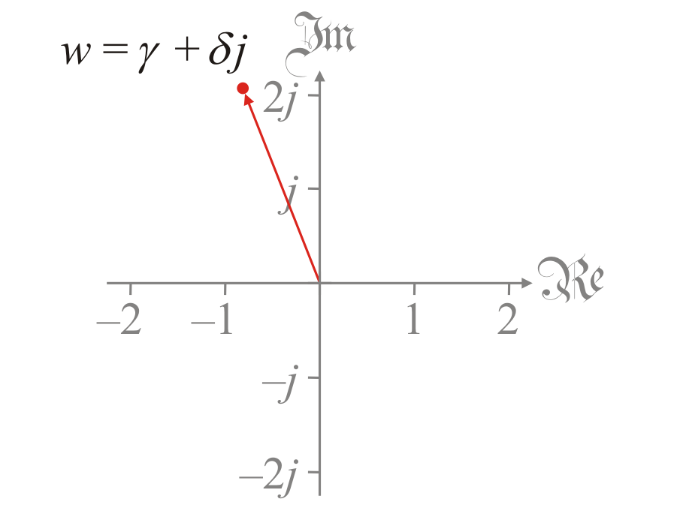
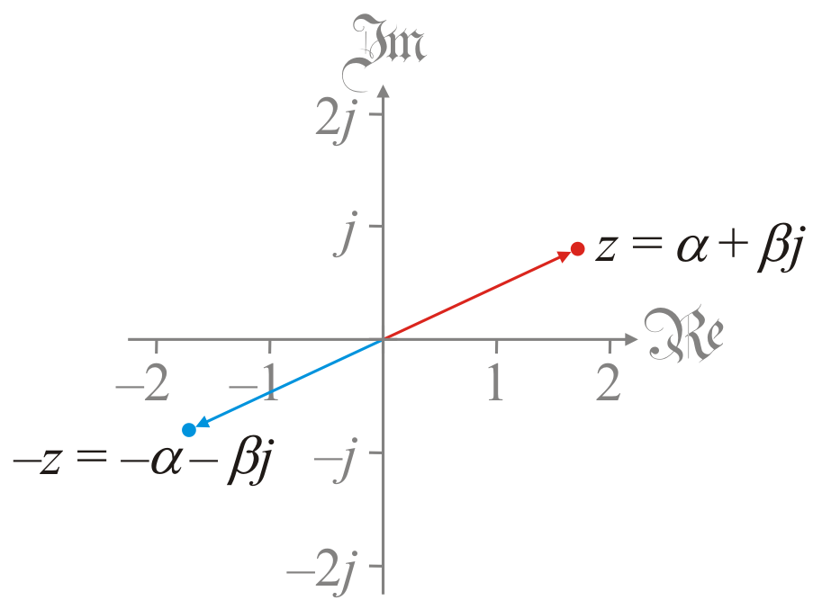
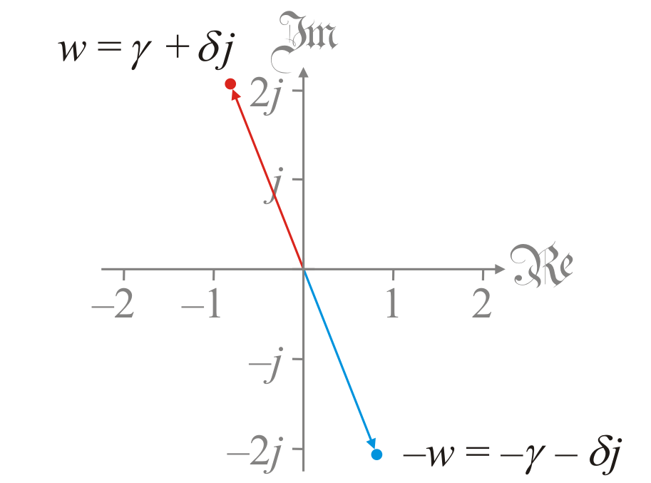
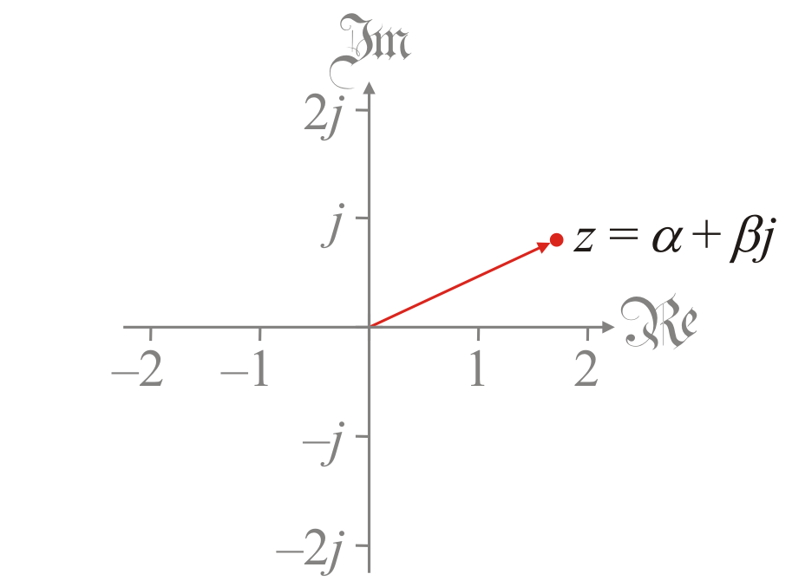
Complex addition
Going back to our geometric interpretation:
The additive inverse is the reflection of a complex number through 0

Slide 6
Observation
Theorem: –z = (–1) z
What this says is: Given z, we can find –z by multiplying z by –1
Proof: If ,
it follows that
Note, we only used the properties of fields
Thus, in any field, we can find –z by multiplying z by the additive inverse of 1
QED

Slide 7
Summary
In this topic, we’ve introduced the additive inverse
Given z, we found –z so that z + (–z) = 0
We saw the geometric interpretation as a reflection through 0
We can find –z by multiplying z by the additive inverse of 1, or –1
We will, of course, refer to –z as “minus zed”

Slide 8
References
[1] https://en.wikipedia.org/wiki/Additive_inverse
[2] https://en.wikipedia.org/wiki/Complex_number#Field_structure

Slide 9
Acknowledgments
None so far.

Slide 10
Colophon
These slides were prepared using the Cambria typeface. Mathematical equations use Times New Roman, and source code is presented using Consolas.
The photographs of flowers and a monarch butter appearing on the title slide and accenting the top of each other slide were taken at the Royal Botanical Gardens in October of 2017 by Douglas Wilhelm Harder. Please see
https://www.rbg.ca/
for more information.

Slide 11
Disclaimer
These slides are provided for the ne 112 Linear algebra for nanotechnology engineering course taught at the University of Waterloo. The material in it reflects the authors’ best judgment in light of the information available to them at the time of preparation. Any reliance on these course slides by any party for any other purpose are the responsibility of such parties. The authors accept no responsibility for damages, if any, suffered by any party as a result of decisions made or actions based on these course slides for any other purpose than that for which it was intended.

